Slide 1

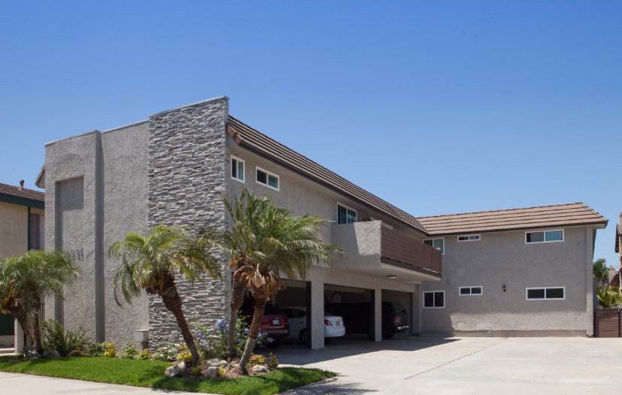
A CONSERVATIVE REAL ESTATE STRATEGY
5 Units - 16941 Hoskins Lane, Huntington Beach

Slide 2
CAPITAL DEPLOYMENT
VWC currently has an available equity base of $12MM and purposes to develop a programmatic LP relationship with one, and as many as four co-invest partners.
The equity will be coupled with bridge and permanent debt capital, bringing an aggregate buying power to over $240,000,000, assuming a 55% LTC and $20,000,000 allocated to Capital Expenditures (the aggregate cost of renovation).
VWC has applied a fix-and-flip model with apartment assets for the past seven years, averaging a project-level return of over 20% per year. We now have a remaining portfolio of five apartment assets in Orange County and a perimeter city; 41 multifamily units. We anticipate purchasing 100 additional units in the calendar year 2020. Thereafter, VWC purposes to selectively acquire 250 additional units per year in 2021-23, for a total multifamily portfolio of 891 units, or a post-renovation market cap of over $330MM with an average price per unit of $370,000.
It is expected that the average deal size will include an occasional “super-sized” asset. This deal size, up to and including 75 units, will drive a mean deal size of approximately 32 units, at 8 acquisitions per year for three years, or 24 properties.

Slide 3
THE STRATEGY – SCALABLE, DEFENDABLE, SUSTAINABLE & PROFITABLE
Repeatable Renovation Strategy We use specific measurements through an EOS System to ensure measurable efficiencies in every operating area of execution; acquisition, renovation, management, and the recapitalizing processes. A clearly articulated renovation process is critical to accurately measuring on- the-ground activity
Fragmented Broker Community The brokers for sub-institutional multifamily properties are primarily residential agents who value being taught the business from an experienced Operator. 85% of all transactions in this targeted apartment niche are through the residential brokerage community.
Third-Party Onsite Property Mgt. Companies that have been vetted and approved
I. SCALABLE

Slide 4
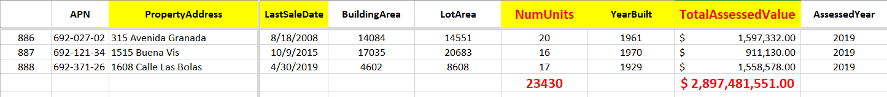
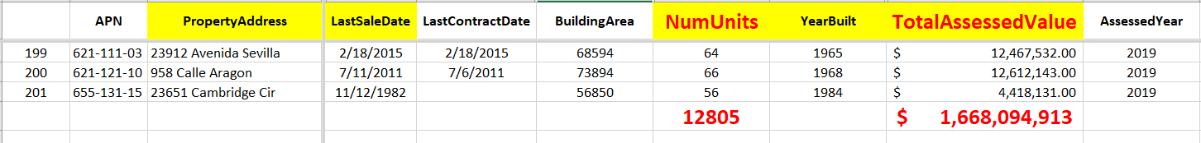
Orange County has over 4,400 sub-Institutional apartment properties and 59,000 units. Inventory is large in quantity and competition is sub-institutional.
5-15 Units, Orange County, CA
16-50 Units, Orange County, CA
51-75 Units, Orange County, CA

Slide 5
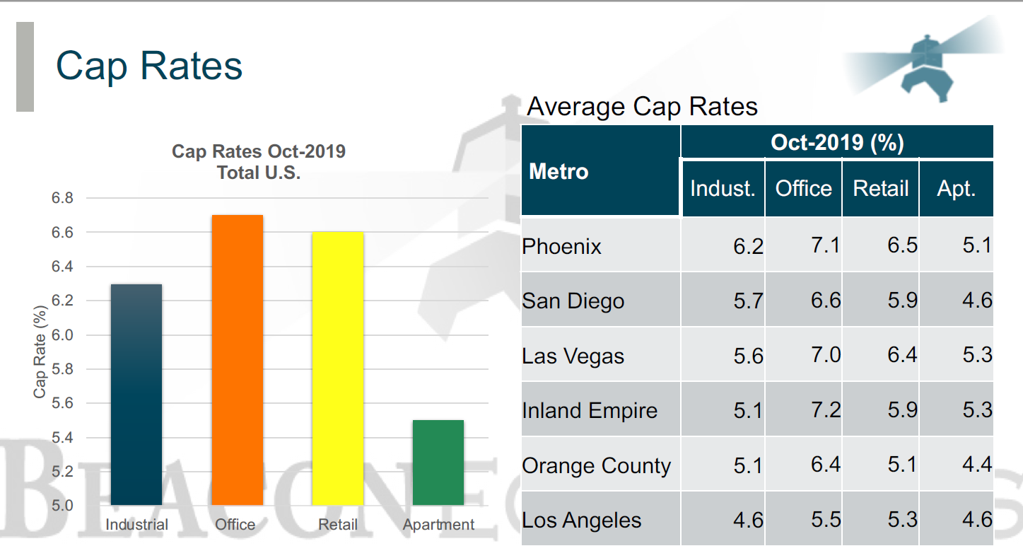
Apartments continue to be viewed as the most conservative investment real estate product-type measured by the lower overall cap rates.

Slide 6
II. DEFENDABLE
Institutions are not interested Large real estate equity firms cannot gear-up to work on such small (by comparison) deals. This special niche is filled with Mom and Pop Buyers and Sellers, giving VWC a material advantage in a small and targeted niche
Brokers are less sophisticated 15% of all transactions are executed by five regional brokerage firms. The remaining transactions have been one-and-done agents
Internal Controls Our extreme measurability would be easier to purchase than to duplicate
We are big fish in a small pond We are, arguably, one of the most active buyers and sellers in our space.

Slide 7
A tight labor market and the shortage of available housing is causing a commensurate rise in rents, confirming that the community of renters will continue to increase.
III. SUSTAINABLE
Plenty of Inventory There are 4,449 multifamily properties in Orange County between 5 and 75 units; a total of over 59,000 units of apartments
An additional 201 Multifamily properties in sizes from 51 units to 75 units add another 13,000 apartment units.
Our 3-year objective is to own 891 units with a market cap of over $300 MM.
Sandwich Generation An increasing number of both, Baby Boomers and Millennials are choosing to rent vs own. The gap in housing costs between owning and renting a 2 bdrm apartment is over $2,200 per month in Orange County*.

Slide 8
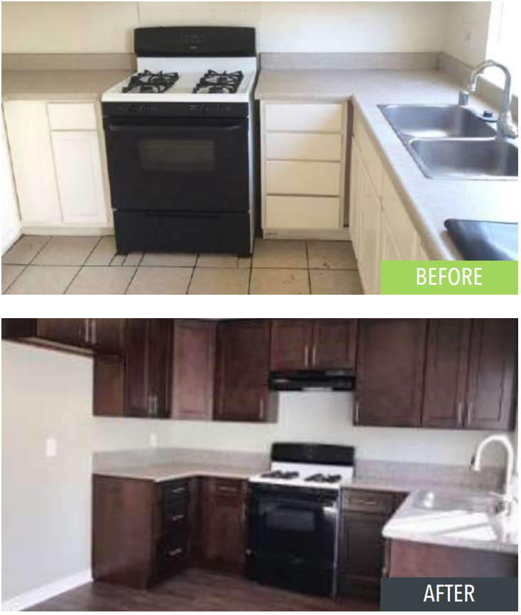
501 ENCINITAS WAY - PLACENTIA
TRANSACTION SUMMARY
An opportunity to invest in a 4-unit multifamily townhome located in a residential area of Central Orange County whereby existing leases were 22% below the local market. The business strategy was to complete a significant unit by unit renovation and create a positive cash flow in Year 1.
A note of interest, two of the existing tenants retained their residency at the property at the “new” market rental rate.
BEFORE
PROPERTY SUMMARY
Units: | 4
Year Built: | 1977
Acq. Date / Price: | February 2016 / $1,150,000
Sale Date / Price: | July 2017 / $1,450,000
Hold Period: | 18 months
Monthly Rent Increase: | 21.35%
Investor ROI: | 1.3x
AFTER

Slide 9
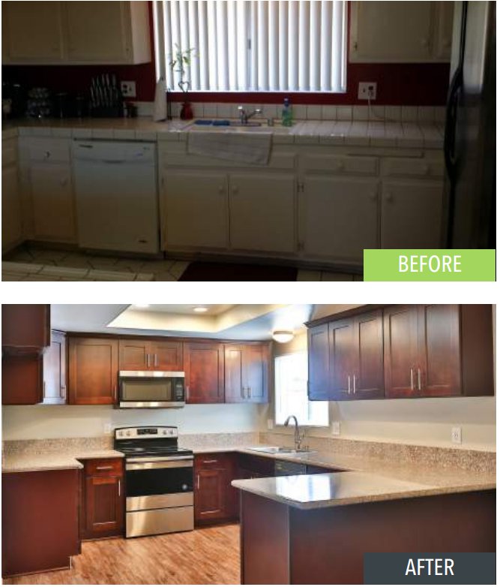
16941 HOSKINS LANE – HUNTINGTON BEACH
TRANSACTION SUMMARY
A 5-unit property built in 1974 located in a highly desirable coastal community offering a “beachside lifestyle” with dated interiors and below market rents.
Capital improvements of approximately $190,000 saw an average increase of 48.54% or $735 in average rental rate increase/unit/month.
BEFORE
PROPERTY SUMMARY
Units: | 5
Year Built: | 1987
Acq. Date / Price: | April 2017 / $2,000,000
Sale Date / Price: | April 2018 / $2,850,000
Hold Period: | 12 months
Monthly Rent Increase: | 48.50%
Investor ROI: | 1.3x
AFTER

Slide 10
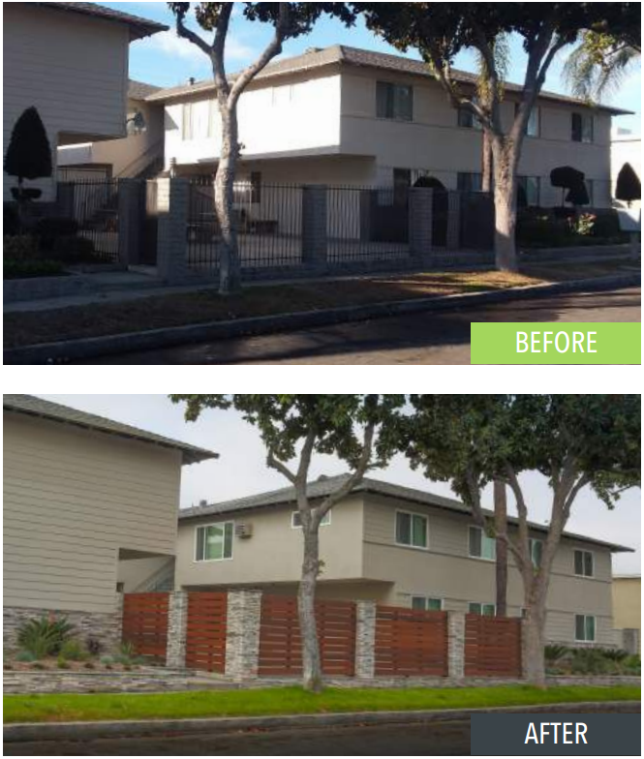
2630 WEST PORTER AVE - FULLERTON
TRANSACTION SUMMARY
An 11-unit property built in 1965 located in Fullerton, a city experiencing major activity in residential, retail and mixed use space redevelopment, with top rated schools and easy access to employment centers, shopping and entertainment.
The property met our criteria of a value-add opportunity with market rent upside potential. At the time of sale, the per unit price of $393,181 set a new record for the local market.
BEFORE
PROPERTY SUMMARY
Units: | 11
Year Built: | 1965
Acq. Date / Price: | October 2017 / $3,250,000
Sale Date / Price: | November 2018 / $4,325,000
Hold Period: | 13 months
Monthly Rent Increase: | 24.97%
Investor ROI: | 1.2x
AFTER

Slide 11
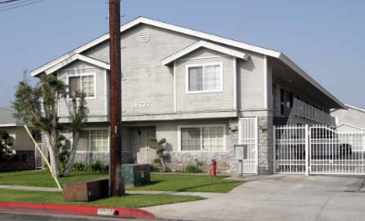
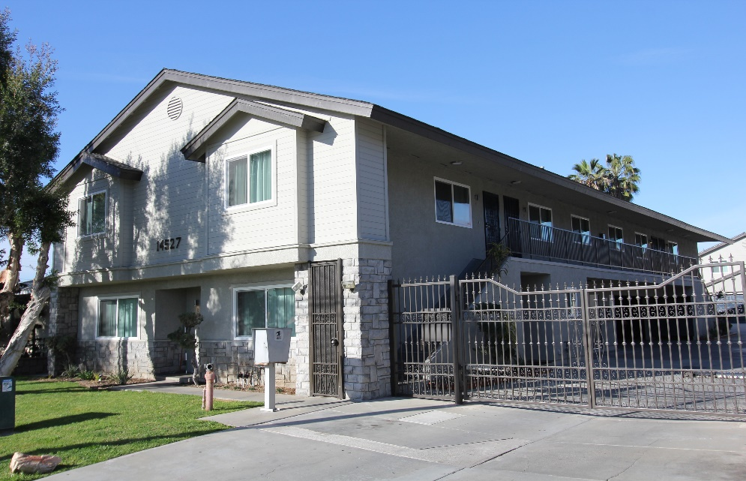
14523 & 14527 S Budlong Ave. - GARDENA
TRANSACTION SUMMARY
A 12-unit property built in 1989 located in Gardena, an active and progressive community with family-oriented neighborhoods attractive for all residents. Gardena is an ideal centralized location with access to all major freeways and LAX.
The property met our criteria of a value-add opportunity with market rent upside potential in excess of 26% at the time of acquisition.
BEFORE
PROPERTY SUMMARY
Units: | 12
Year Built: | 1989
Acq. Date / Price: | July 2018 / $3,490,000
Sale Date / Price: | December 2019 / $4,592,400
Hold Period: | 17 months
Monthly Rent Increase: | 39.94%
Investor ROI: | 1.42x
AFTER

Slide 12



PROFESSIONAL SERVICES:

Slide 13
Sanford D. Coggins
(sanford@visionwisecapital.com)
Address:
27525 Puerta Real, Suite 100-164
Mission Viejo, CA 92691
Phone: (949) 441-5580
Fax: (949) 441-5586

